Slide 1

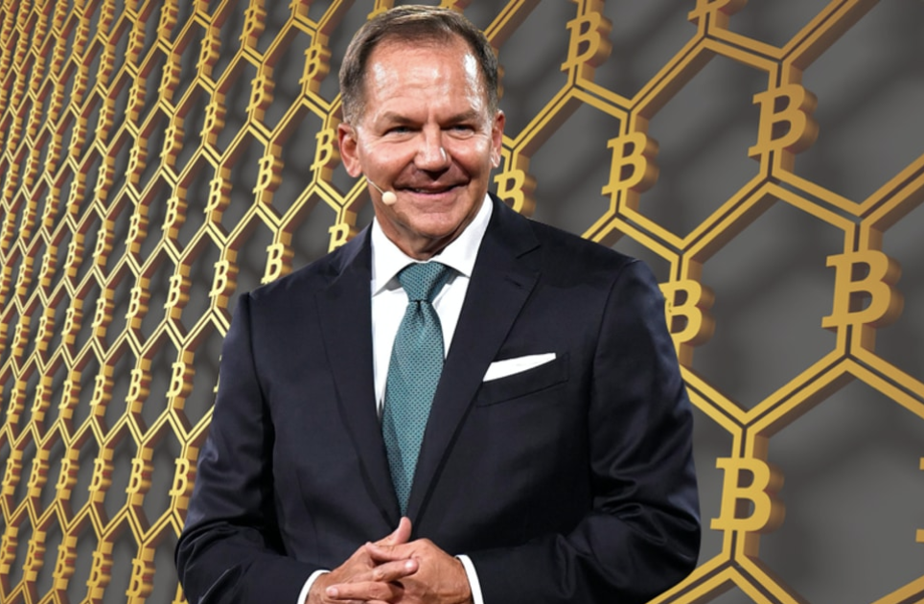
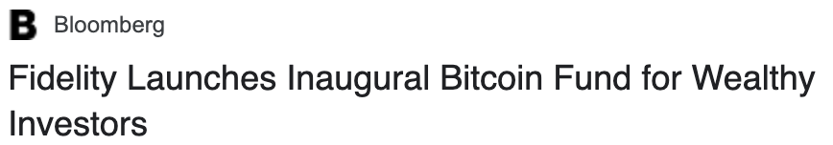

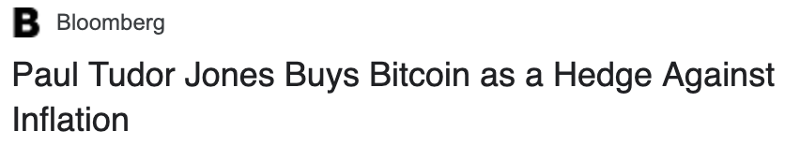

Motivation
Big and reputable players are starting to bet strongly on Bitcoin:
As soon as another bull market comes along there is going to be an explosion in demand for causaLens and crypto related products.
WE BETTER BE READY!!!

Slide 2




Predicting Crypto Assets Liquidity in Real-Time with Causal AI
www.causaLens.com
info@causaLens.com

Slide 3
Added Value

Slide 4






Value Add - Automation
Equip yourself with an “army” of virtual PhD Quants
Automated Data Searching
Automated Data Preparation
Automated Causal Discovery
Automated Model Building & Evaluation
Optimisation of Business KPI e.g Trading Strategy
Automated Feedback Loop
Explainable Causal Insights
Full Control & Transparency of the discovery process & results

Slide 5
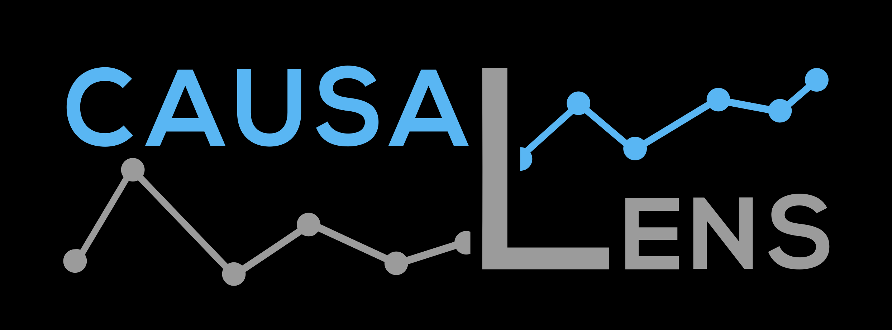
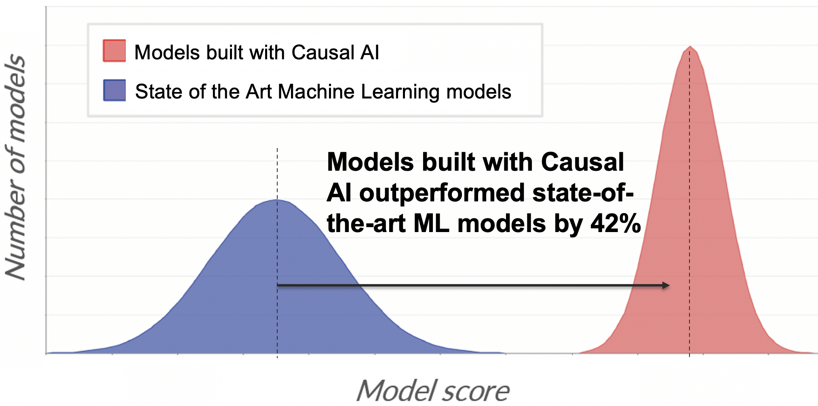
Value Add – Unique IP
Access the latest Technology & IP that is licensed by even the largest & most sophisticated systematic funds
Current Machine Learning Overfits
Current Approaches
✓
✘
Dynamic models
Static models
Causal drivers
✘
✓
Historical correlations
Explainable
Black box
✘
✓

Slide 6
Use Case Predicting Crypto Assets Liquidity in Real-Time with Causal AI

Slide 7
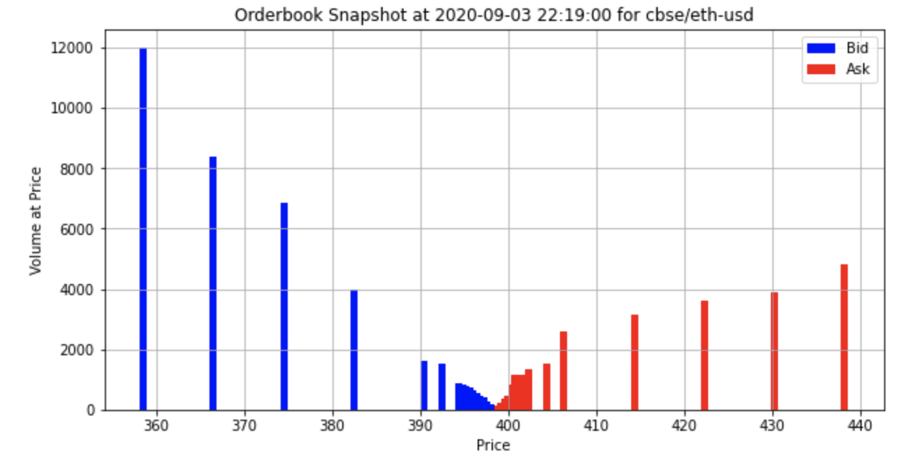
Data
Order book data
13 exchanges
6 pairs
Spot price & Futures contracts
1-minute frequency
Sentiment data:
93 different sentiment metrics including
Social media positive/negative/hope/fear
New material publication
Event data

Slide 8
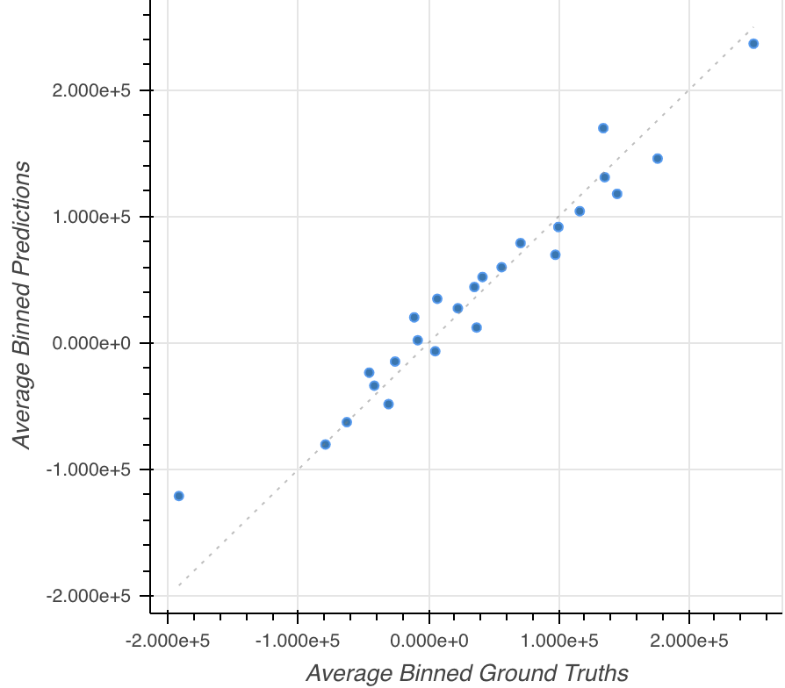
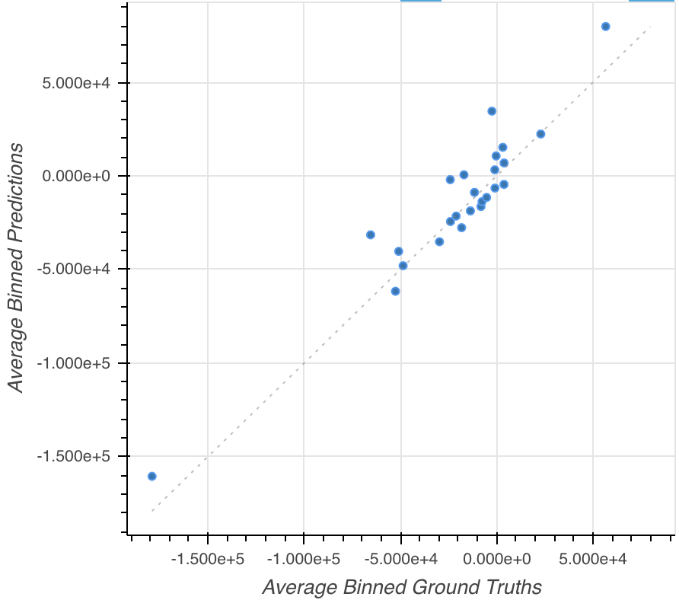
Insights – Execution costs
causaLens’ Platform can be used to accurately predict execution costs across the crypto markets
Even during extreme events
BTC
ETH

Slide 9
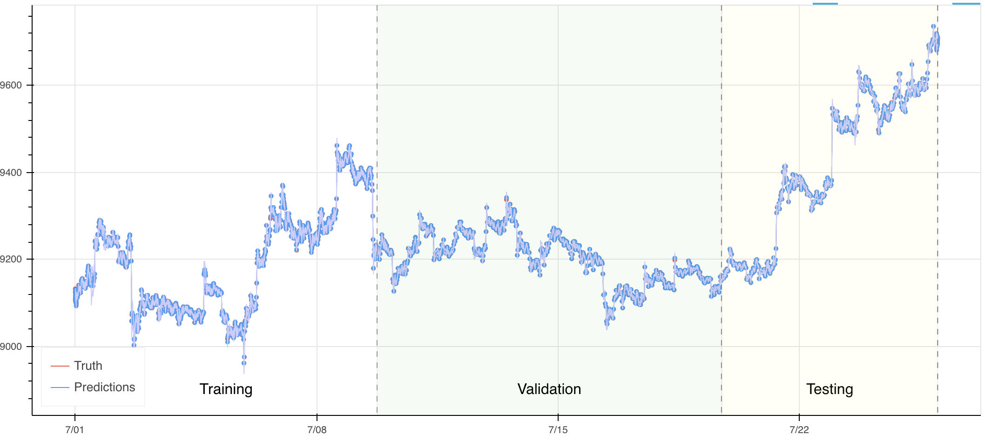
Insights – Sentiment data
causaLens’ Platform can be used to autonomously evaluate datasets
BTC aggregate price
5% Higher Directional Accuracy and 29% Higher Score than models not using sentiment
Autonomously Identified News containing ‘Ban’ as most predictive indicator for price change

Slide 10
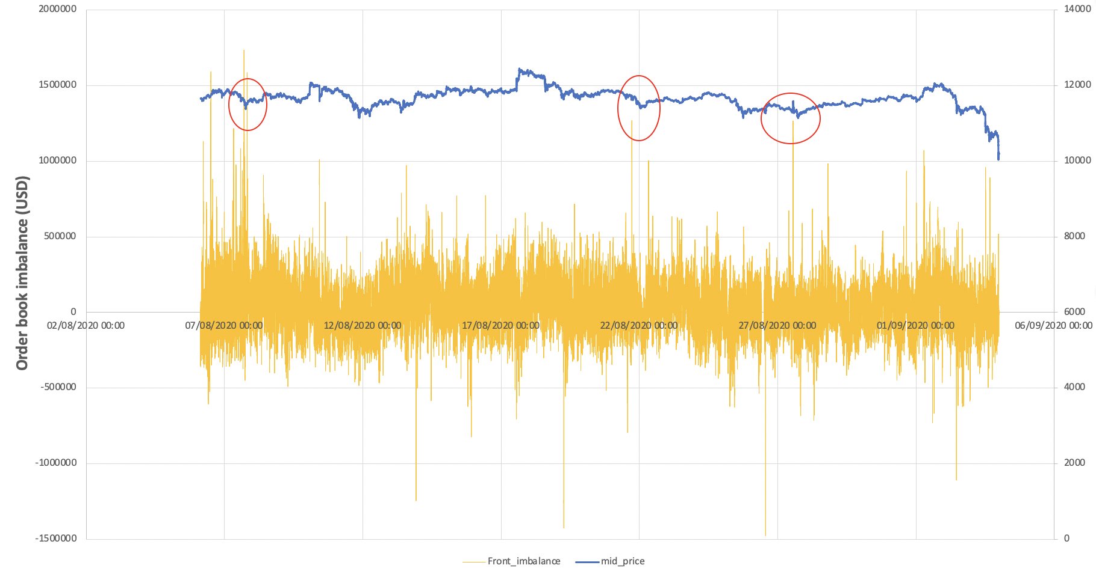
Insights – Orderbook Imbalance
Measuring order book imbalance (Bid volume – Ask volume) * price:
‘Front imbalance’: < 0.1% away from mid-price
‘Mid imbalance’:
< 1% away from mid-price
‘Imbalance’:
Imbalance of whole orderbook
Clear relationship between imbalances and big price movements

Slide 11
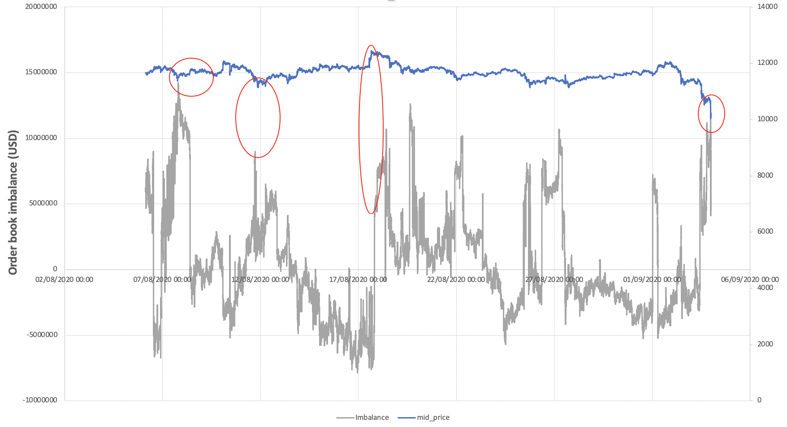
Insights – Orderbook Imbalance
Relationship even more visually clear when taking whole orderbook

Slide 12
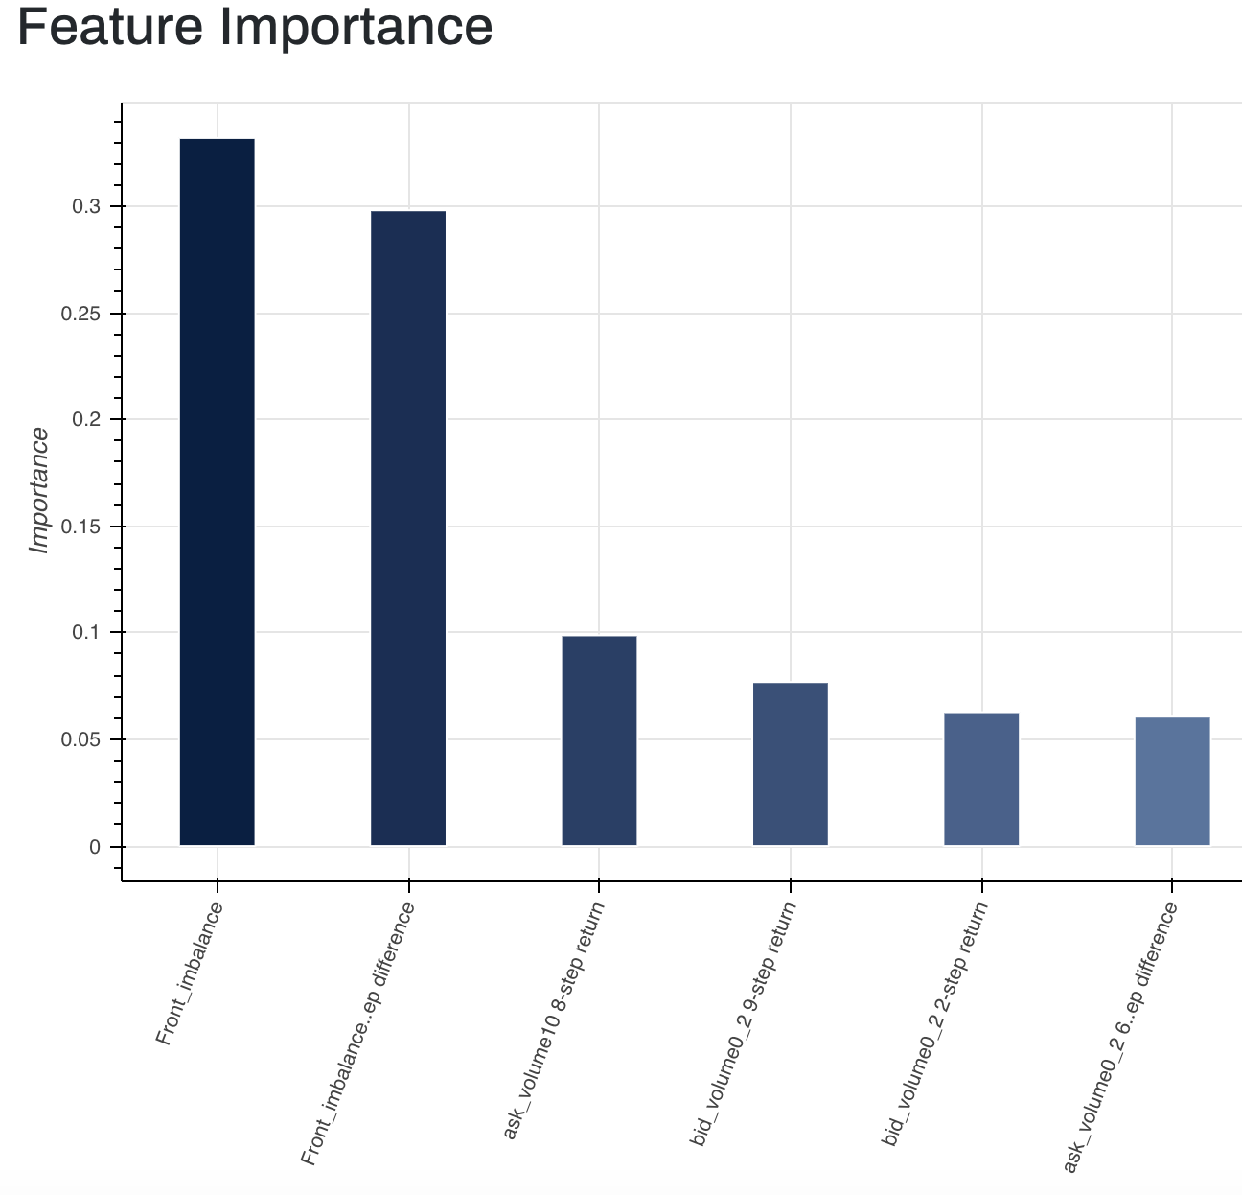
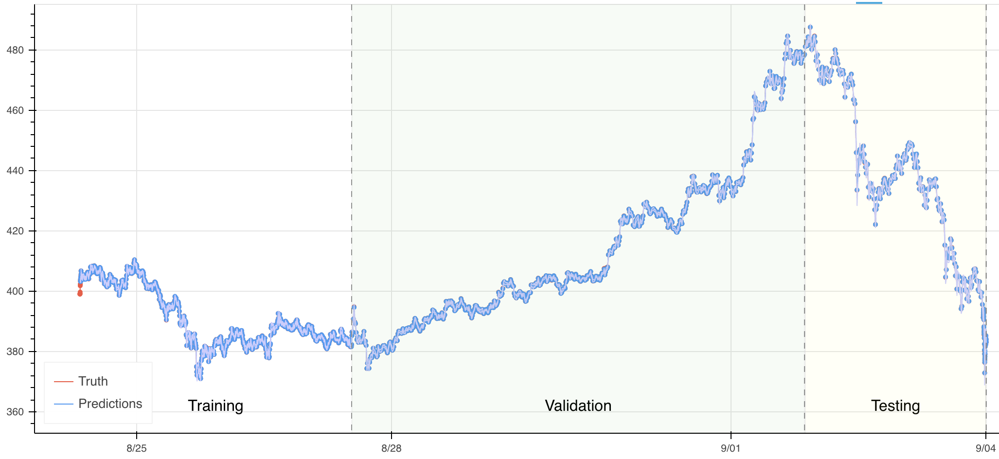
Insights – Predictions with Orderbook Information
Predicting ETH price using orderbook information
Front imbalance is strong predictor of ETH price

Slide 13
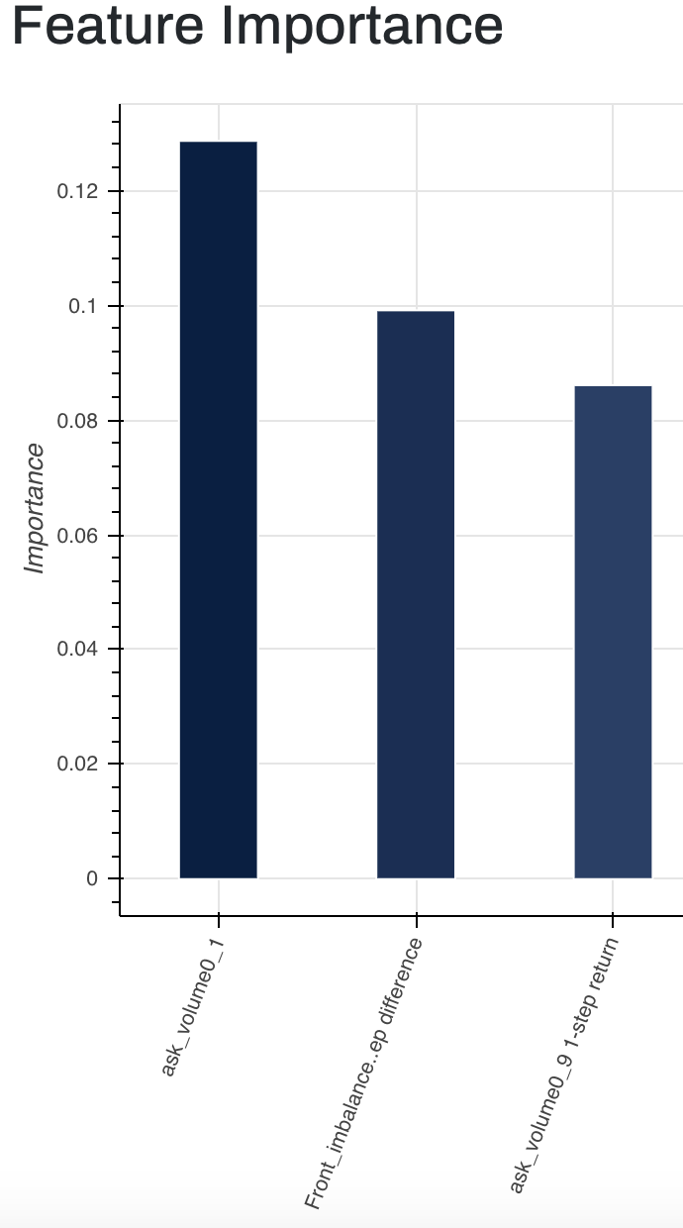
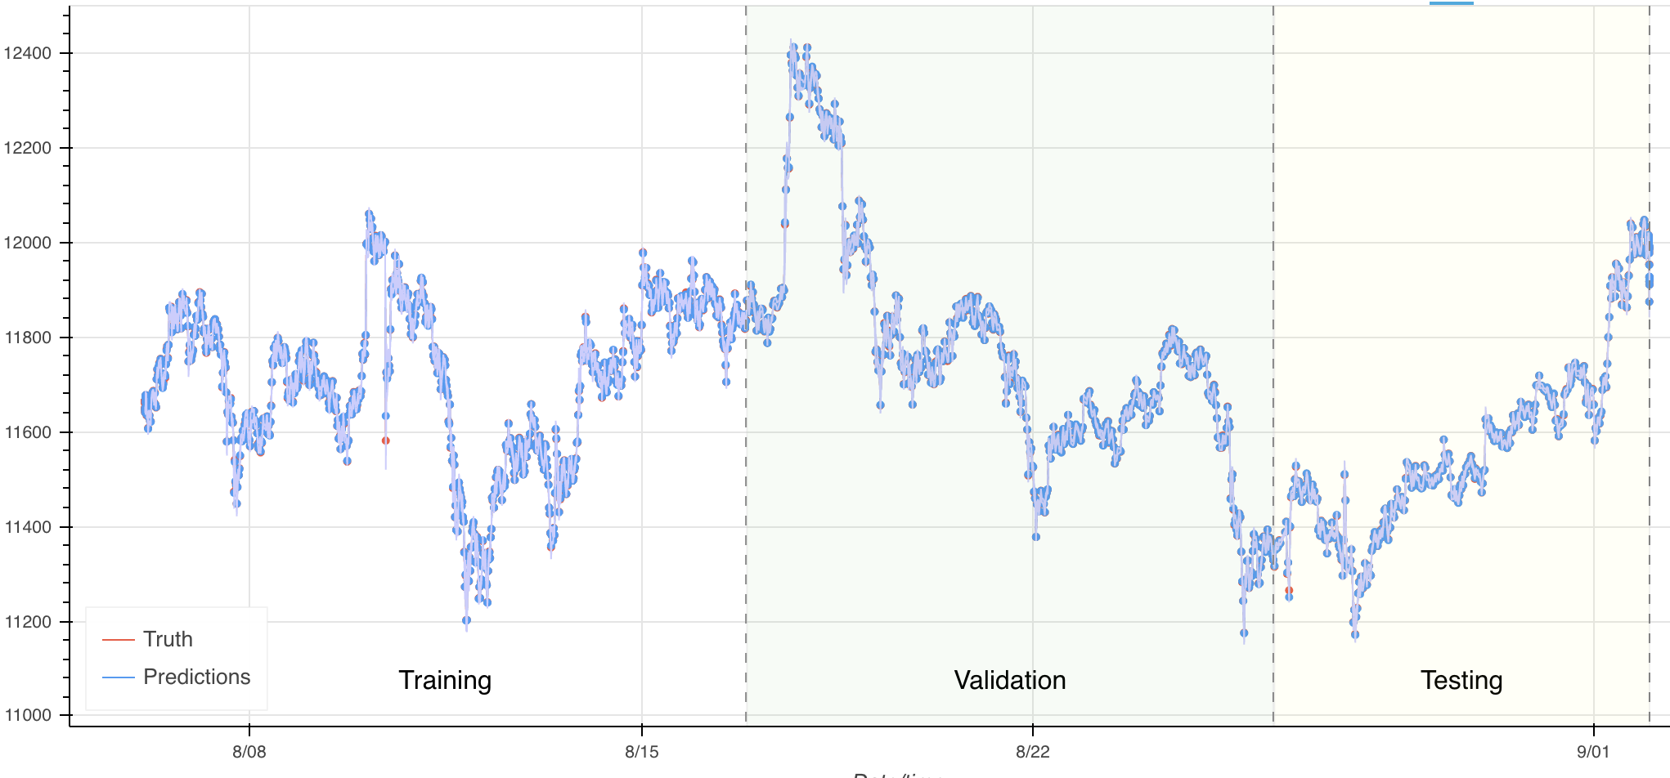

Insights – Predictions with Orderbook Information
Predicting BTC price using orderbook information
Front imbalance is less of a strong predictor of BTC price than ETH
‘Front’ ask volume strong predictor too

Slide 14
About us

Slide 15




Serving the most sophisticated institutions
Investment
Banking
Asset
Management
Market Making
and HFT
Hedge
Funds
Largest European Bank
Clients managing
$2 trillion
Two of the largest five global firms
Smallest client manages $20 billion
Models to predict order volumes and client activity
Causal drivers for a range of asset classes
Improved real-time market making
Predictive signals for all types of strategies
Impact
Improved execution performance & client services
Impact
More profitable trading strategies at the fraction of the cost
Impact
New signals, improved margins & protection against adversaries
Impact
Generation of outperformance across all strategies

Slide 16
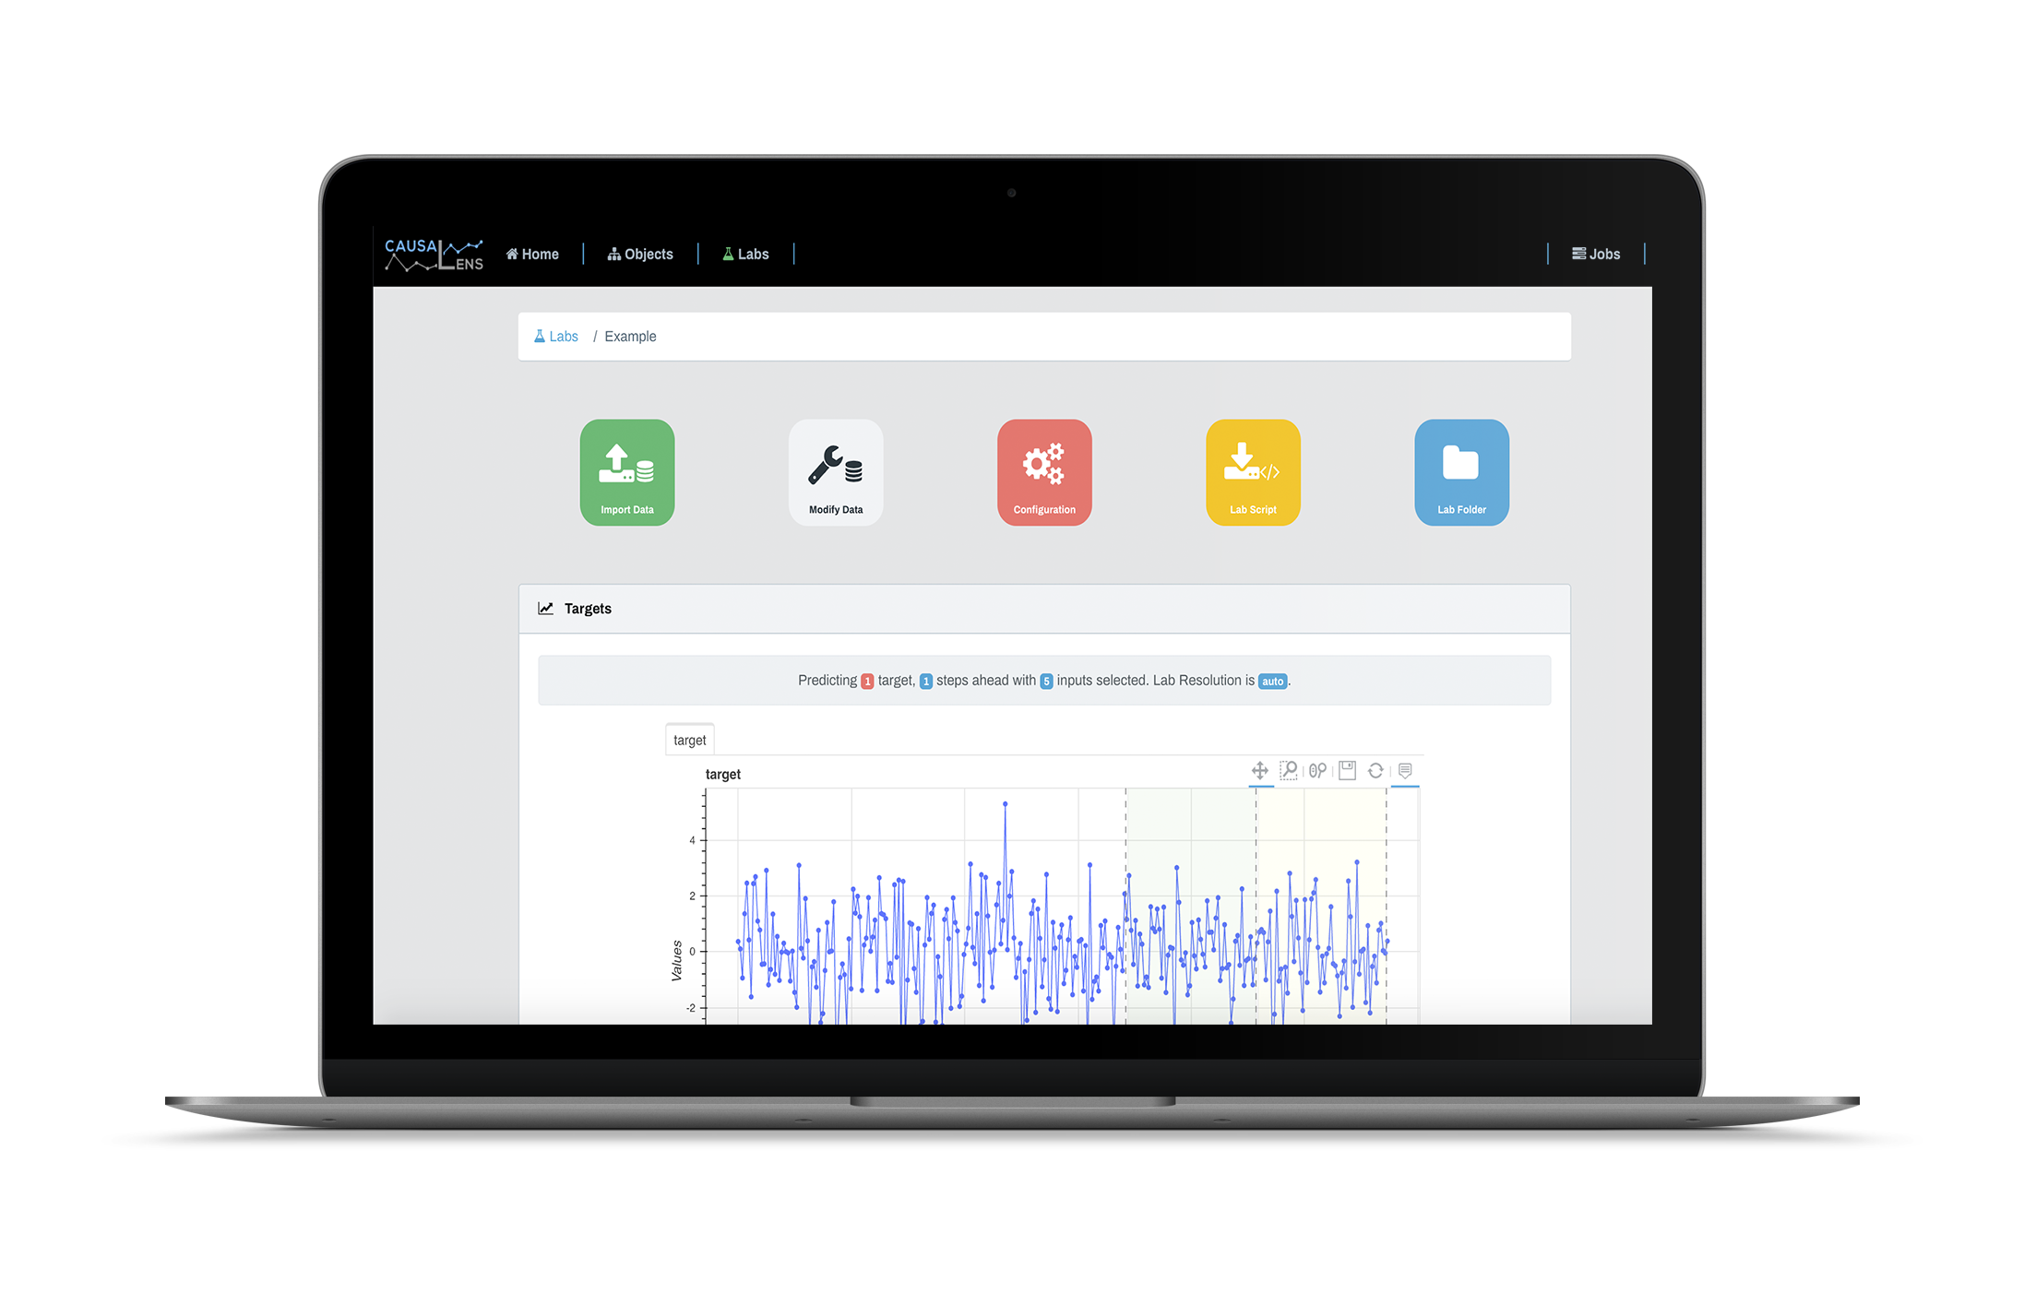
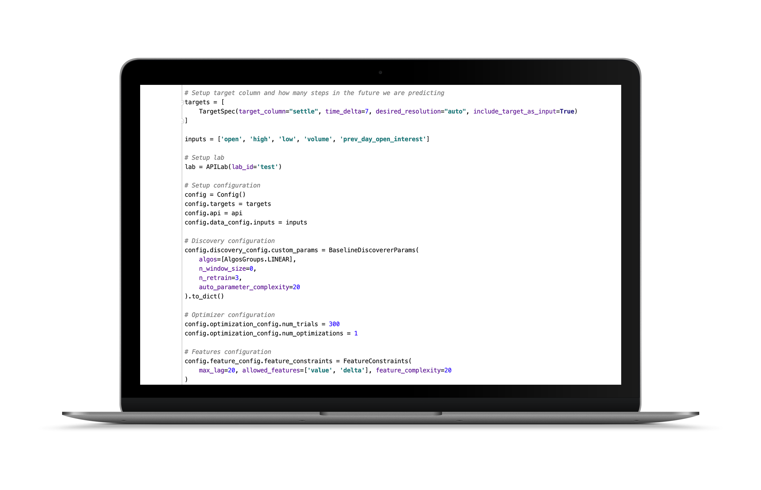
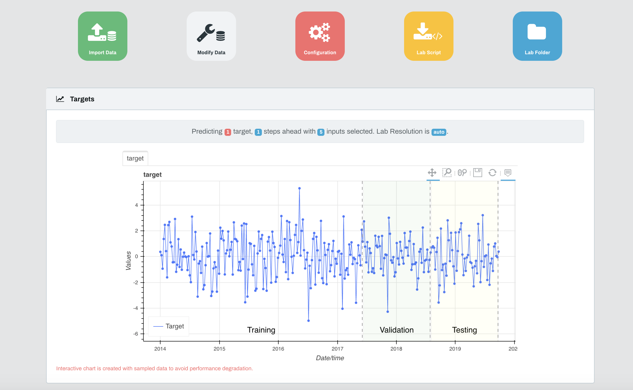
Empower Teams Throughout Your Business
User Interface - Intuitive and customisable
API - Powerful and easy to integrate
Empower Domain Experts
Empower Technology Teams

Slide 17
Seamless Integration in Your Workflows
1
Hour
96%
To proven value
on your problem
Pilot customer
conversion
Deployed Anywhere
Fully Managed Private Cloud
On-Prem
Library
Subprocess
Microservice via REST
On the Edge

Slide 18
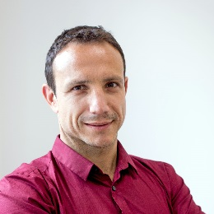








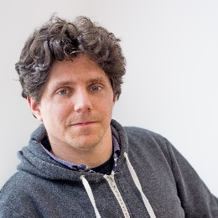
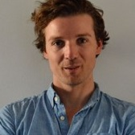







causaLens Attracts Top Scientists
Executive Team
Advisory Board
Dr. Darko Matovski, PhD
CEO
60%
50
Jose Marques, PhD
Ex-Head of Trading
Bridgewater
Top Hedge Funds in London
Part of teams managing $ billions
Of Current Team are PhDs
One of the Fastest Growing AI Companies
New PhD Hires
within 12 months
Commercialising AI research
(workplace of Alan Turing)
Mark Roomans, PhD
CEO Morningstar (EMEA)
PhD Machine Learning
Dr. Maksim Sipos, PhD
CTO
Best Investment in Deeptech Award [Link]
Machine Learning Companies to watch in Europe [Link]
Theo Mollinger
Senior Director Moody’s
Top Hedge Funds in the US
Trading strategies & peta-size systems
Institutional Investors
Software Engineering at CTO level
PhD Physics
100 most disruptive companies [Link]
Virtual Data Scientists and the War for talent [Link]

